Slide 1

Data Structures and Algorithms - 3
(25CS2103E)
Digital Library Search System
Team Members:
2520030476 – Tej Pratap
2520030343 – B. Aryan
Under the Esteemed Guidance of
Dr. V. Sireesha

Slide 2
Contents
1
Abstract
6
6
Results & Conclusion
2
Introduction & Literature Survey
7
7
Future Scope
3
Problem Statement & Objectives
4
System Architecture & Workflow
5
Hardware and Software Requirement
02

Slide 3
Abstract
          Simplifies digital library resource searching and retrieval.
          Uses Data Structures and Algorithms (DSA) for efficient searching.
          Manages books, journals, magazines, and research papers.
          Provides a centralized repository for library resources.
          Supports searching by: Title, Author, ISBN, Category, Keywords
          Uses arrays, hashing, indexed structures, and string-matching techniques.
          Supports exact-match, keyword, and pattern-matching searches.
          Enables users to store, organize, search, and retrieve resources.
          Reduces manual effort and search time.
          Improves data organization and search accuracy.
          Provides faster access to library resources.
          Can be extended with fuzzy matching and ranked relevance.
          Demonstrates the practical application of DSA to a real-world information-retrieval problem.
          Provides an efficient and user-friendly library search application.
Search by Title, Author, ISBN, Category or Keyword...

Slide 4
Introduction
          Managing and searching digital library resources is an important task in academic institutions.
          Libraries contain large and growing collections of books, journals, magazines, and research papers.
          These resources need to be maintained and organized regularly.
          Manual or basic searching methods can make it difficult and time-consuming to locate a specific resource.
          The Digital Library Search System provides a simple solution to this problem.
          It organizes all library resources in a centralized and structured repository.
          The system uses Data Structures and Algorithms (DSA) to perform searches efficiently.
          Users can search resources by title, author, ISBN, category, or keyword.
          Efficient indexing and string-matching techniques are used to improve search performance.
          The system is designed to be easy to use, accurate, and scalable.
          It also helps students understand the practical applications of DSA in real-life information-retrieval systems.

Slide 5
03 • LITERATURE SURVEY
Literature Survey
          Existing digital library systems store title, author, ISBN, category, and keywords.
          Resources include books, journals, and research papers.
          Traditional systems mainly use linear search.
          Linear search becomes slow with increasing records.
          DSA techniques improve search speed and organization.
          Array-based indexing helps manage records efficiently.
          Hashing enables faster record retrieval.
          Exact-match string search helps locate specific resources.
          The proposed system combines these techniques for a simple, fast, and scalable library search system.
          Future extensions include fuzzy matching and ranked relevance.
05

Slide 6

Problem Statement and Objectives
Problem Statement
Objectives
Libraries contain thousands of books, journals, magazines, and research papers.
Finding specific resources manually becomes time-consuming and difficult as the collection grows.
Basic searching methods are not efficient for large library collections.
A centralized system is needed to store library records efficiently.
Users should be able to quickly search and retrieve information.
The system uses Data Structures and Algorithms (DSA) to improve search efficiency.
Store library records in an organized, centralized repository.
Provide fast searching using:
Title
Author
ISBN
Category
Keywords
Implement efficient data structures for indexing and retrieval.
Use exact-match and string-matching techniques.
Maintain consistent search performance as the repository grows.
Apply DSA concepts to a real-world information-retrieval problem.
Build a scalable foundation for future intelligent and fuzzy search features.
06

Slide 7
System Architecture
System Architecture
System Architecture
User
Browser
User
Browser
User
Browser
Frontend
HTML / CSS / JS
Frontend
HTML / CSS / JS
Frontend
HTML / CSS / JS
Java Backend
HTTP APIs
Java Backend
HTTP APIs
Java Backend
HTTP APIs
DSA Engine
Search / Sort
DSA Engine
Search / Sort
DSA Engine
Search / Sort
Text Files
.txt Storage
Text Files
.txt Storage
Text Files
.txt Storage
Frontend Layer
Displays search, results, analytics, and admin screens.
Sends requests to Java backend APIs.
Frontend Layer
Displays search, results, analytics, and admin screens.
Sends requests to Java backend APIs.
Frontend Layer
Displays search, results, analytics, and admin screens.
Sends requests to Java backend APIs.
Backend Layer
Loads records from text files.
Builds indexes and runs DSA algorithms.
Backend Layer
Loads records from text files.
Builds indexes and runs DSA algorithms.
Backend Layer
Loads records from text files.
Builds indexes and runs DSA algorithms.
07

Slide 8
Flow Chart
User enters
search query
Select search parameter
Title / Author / ISBN
Category / Keyword
Search indexed repository
using DSA techniques
Match
Found?
Start
Yes
No
Display matching
resource details
Display
No results
found
End
08

Slide 9
Features of the Project
Search
Search by Title, Author, ISBN, Category, and Keywords.
Supports exact, keyword, and fuzzy search.
Repository
Around 50,000 records.
Books, Journals, Research Papers, Magazines.
Admin
Add, update, delete and manage resources.
Changes are saved in text files.
Analytics
Shows dataset and search insights.
Useful for final project demonstration.
Algorithm Lab
Demonstrates CO1 to CO6.
Shows DSA concepts clearly.
User Interface
Modern responsive website.
Simple and easy to use.
09

Slide 10
CO1–CO6 Mapping
How the project connects course outcomes with concrete algorithm demonstrations.
CO1
Algorithm Selection
Classifies the query and selects a suitable search strategy.
CO2
String Algorithms
KMP, Z-Function, Rabin–Karp, Suffix Array / LCP.
CO3
Dynamic Programming
Edit Distance for fuzzy-search demonstrations.
CO4
Network Flow
Ford–Fulkerson / Edmonds–Karp allocation demo.
CO5
Approximation
Set Cover / Vertex Cover optimisation demo.
CO6
Randomized & Parallel
Randomized QuickSort, Reservoir Sampling, Parallel Search.
10

Slide 11
Tools, Technologies & Algorithms
Programming & Storage
Data Structures
Algorithms
• Java
• HTML / CSS / JavaScript
• Structured .txt files
• Java File I/O
• Arrays
• Linked Structures
• Hash Tables
• Indexes
• Linear / Binary Search
• KMP • Rabin–Karp • Z-Function
• Merge / Quick Sort
• Edit Distance • Max Flow • Approximation
• Reservoir Sampling • Parallel Search
11

Slide 12
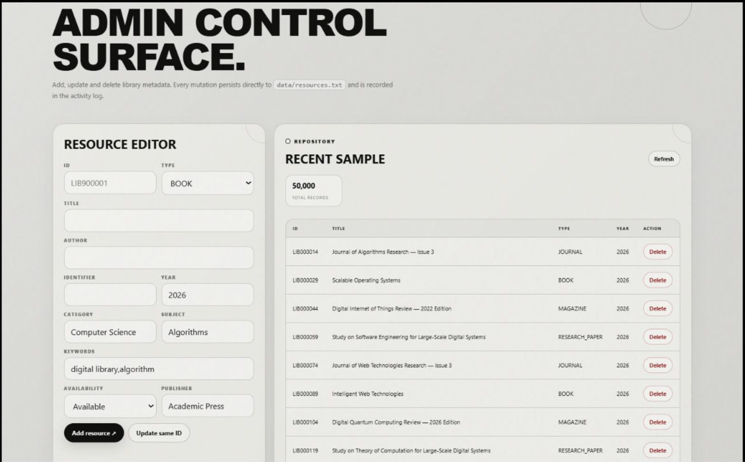
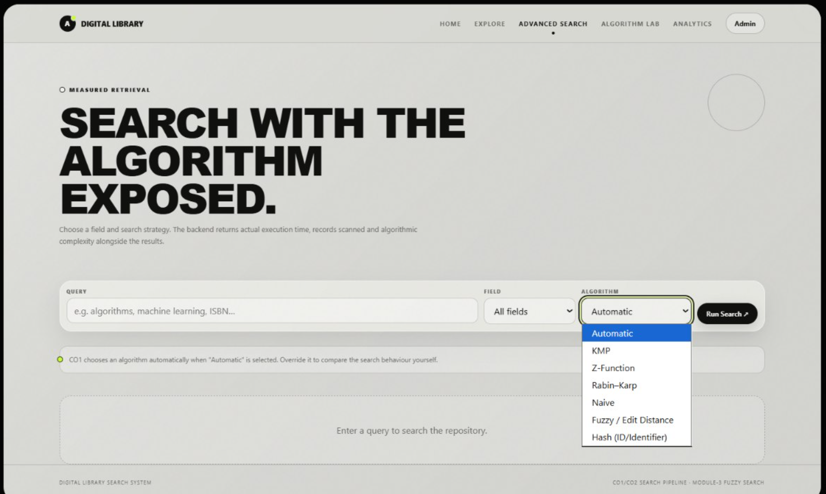
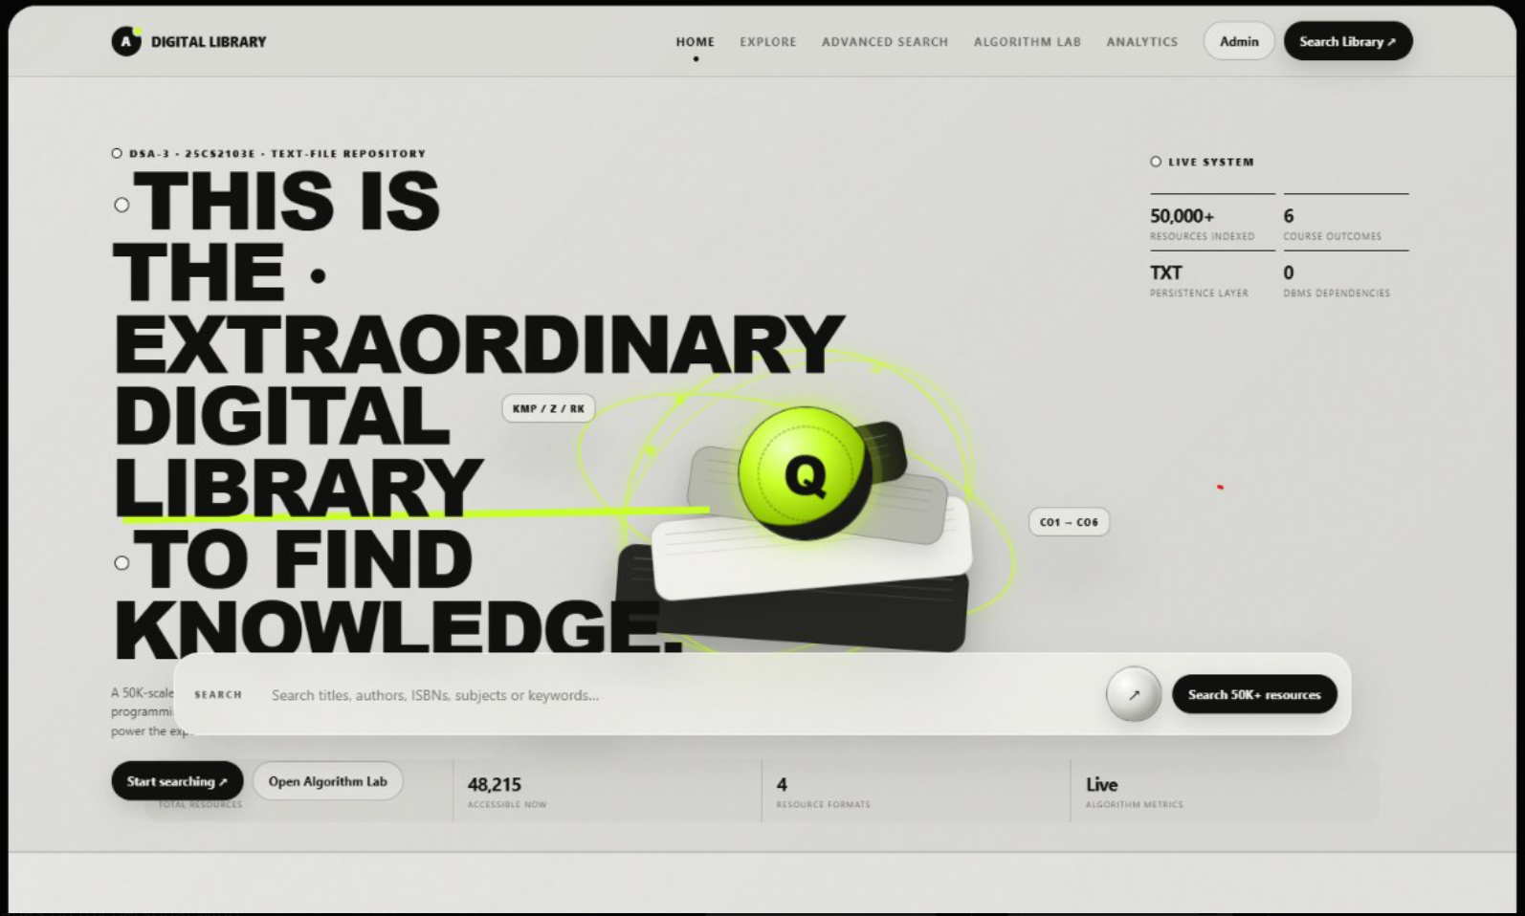
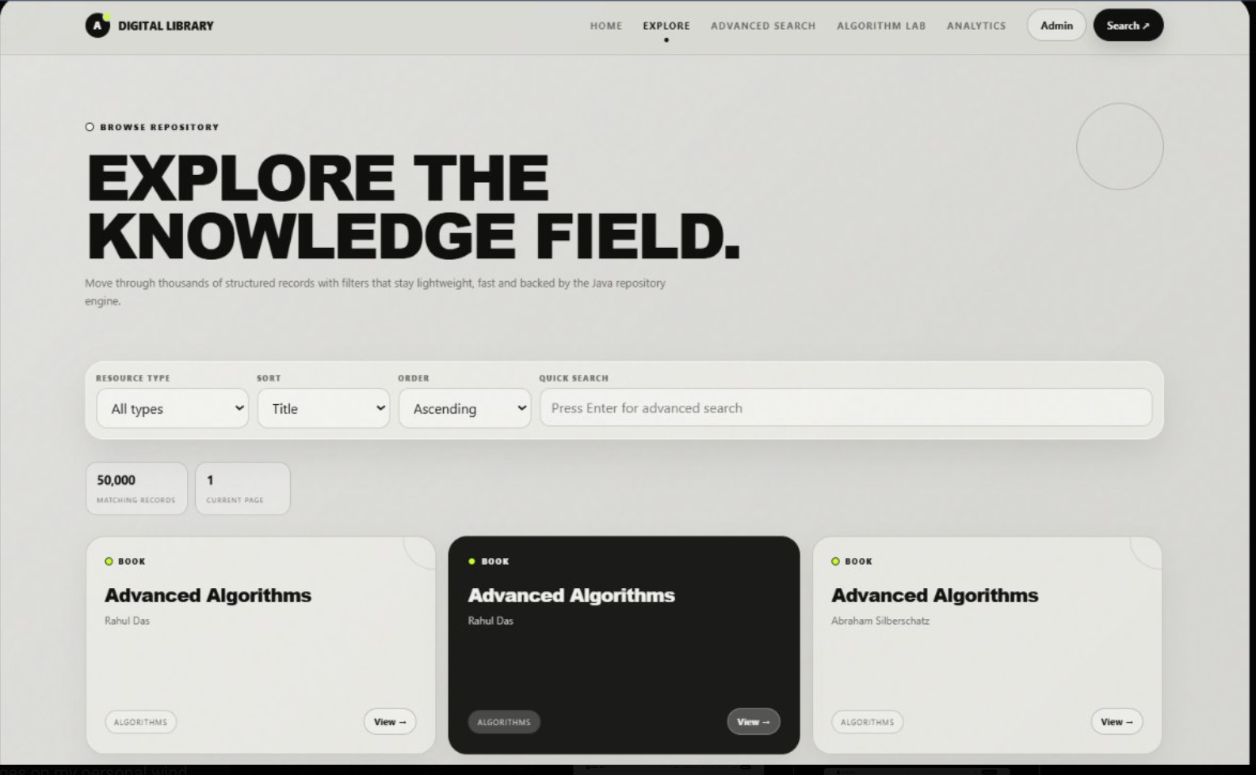
Project Screens
12

Slide 13
Hardware and Software requirements
Hardware Requirements
Software Requirements
Operating System: Windows 10/11, Linux, or macOS
Programming Language: Java
Data Structures / DSA: Arrays, linked structures, hashing concepts, searching and sorting techniques
Database: MySQL
Database Connectivity: JDBC
IDE: VS Code / IntelliJ IDEA / Eclipse
Database Tool: MySQL Workbench
Version Control: Git/GitHub
Processor: Intel Core i3 or above
RAM: Minimum 4 GB
Storage: Minimum 10 GB free space
Keyboard and Mouse
Monitor/Desktop or Laptop
Internet Connection: Optional, for installing software and libraries
14

Slide 14
Conclusion
The Digital Library Search System applies Data Structures and Algorithms to improve library resource searching.
Provides a structured method to store and access library records.
Reduces the need for manual searching through large collections.
Supports multi-parameter search using: Title, Author, ISBN, Category, Keywords
Uses indexed and hash-based structures for faster resource retrieval.
Improves the efficiency and reliability of information retrieval.
Demonstrates the importance of selecting suitable data structures and algorithms.
Helps achieve faster and better data processing.
Provides a scalable and efficient solution as the repository grows.
Offers a user-friendly approach to digital library resource search.
Demonstrates the practical application of DSA in a real-world problem.
Final Conclusion
A scalable, DSA-oriented, text-file based Digital Library Search System with a modern GUI.
14

Slide 15
Future Scope
1
Role-based login for students, faculty and administrators.
2
Improved relevance ranking and intelligent search.
3
Advanced filters: year, subject, type and availability.
4
Detailed usage reports and search analytics.
5
Mobile application and cloud deployment support.
6
An AI chatbot that helps User to Interact easily.
15

Slide 16
THANK YOU
Digital Library Search System • Tej Pratap Singh • B. Aryan • Team 02
16

